Slide 1

Chapter 25 – Configuration Management
Chapter 25 Configuration management

Slide 2
Configuration management
Because software changes frequently, systems, can be thought of as a set of versions, each of which has to be maintained and managed.
Versions implement proposals for change, corrections of faults, and adaptations for different hardware and operating systems.
Configuration management (CM) is concerned with the policies, processes and tools for managing changing software systems. You need CM because it is easy to lose track of what changes and component versions have been incorporated into each system version.
Chapter 25 Configuration management

Slide 3
CM activities
Change management
Keeping track of requests for changes to the software from customers and developers, working out the costs and impact of changes, and deciding the changes should be implemented.
Version management
Keeping track of the multiple versions of system components and ensuring that changes made to components by different developers do not interfere with each other.
System building
The process of assembling program components, data and libraries, then compiling these to create an executable system.
Release management
Preparing software for external release and keeping track of the system versions that have been released for customer use.
Chapter 25 Configuration management

Slide 4
Change management
Organizational needs and requirements change during the lifetime of a system, bugs have to be repaired and systems have to adapt to changes in their environment.
Change management is intended to ensure that system evolution is a managed process and that priority is given to the most urgent and cost-effective changes.
The change management process is concerned with analyzing the costs and benefits of proposed changes, approving those changes that are worthwhile and tracking which components in the system have been changed.
Chapter 25 Configuration management

Slide 5
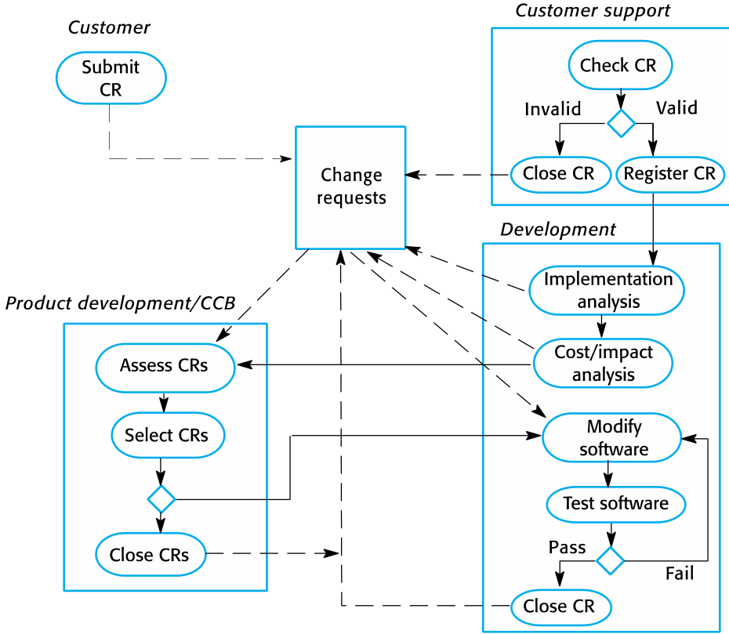
The change management process
Chapter 25 Configuration management

Slide 6
A partially completed change request form (a)
Change Request Form
Project: SICSA/AppProcessing Number: 23/02
Change requester: I. Sommerville Date: 20/01/09
Requested change: The status of applicants (rejected, accepted, etc.) should be shown visually in the displayed list of applicants.
Change analyzer: R. Looek Analysis date: 25/01/09
Components affected: ApplicantListDisplay, StatusUpdater
Associated components: StudentDatabase
Chapter 25 Configuration management

Slide 7
A partially completed change request form (b)
Change Request Form
Change assessment: Relatively simple to implement by changing the display color according to status. A table must be added to relate status to colors. No changes to associated components are required.
Change priority: Medium
Change implementation:
Estimated effort: 2 hours
Date to SGA app. team: 28/01/09 CCB decision date: 30/01/09
Decision: Accept change. Change to be implemented in Release 1.2
Change implementor: Date of change:
Date submitted to QA: QA decision:
Date submitted to CM:
Comments:
Chapter 25 Configuration management

Slide 8
Derivation history
// SICSA project (XEP 6087)
//
// APP-SYSTEM/AUTH/RBAC/USER_ROLE
//
// Object: currentRole
// Author: R. Looek
// Creation date: 13/11/2009
//
// © St Andrews University 2009
//
// Modification history
// Version Modifier Date Change Reason
// 1.0 J. Jones 11/11/2009 Add header Submitted to CM
// 1.1 R. Looek 13/11/2009 New field Change req. R07/02
Chapter 25 Configuration management

Slide 9
Version management
Version management (VM) is the process of keeping track of different versions of software components or configuration items and the systems in which these components are used.
It also involves ensuring that changes made by different developers to these versions do not interfere with each other.
Therefore version management can be thought of as the process of managing codelines and baselines.
Chapter 25 Configuration management

Slide 10
Codelines and baselines
A codeline is a sequence of versions of source code with later versions in the sequence derived from earlier versions.
Codelines normally apply to components of systems so that there are different versions of each component.
A baseline is a definition of a specific system.
The baseline therefore specifies the component versions that are included in the system plus a specification of the libraries used, configuration files, etc.
Chapter 25 Configuration management

Slide 11
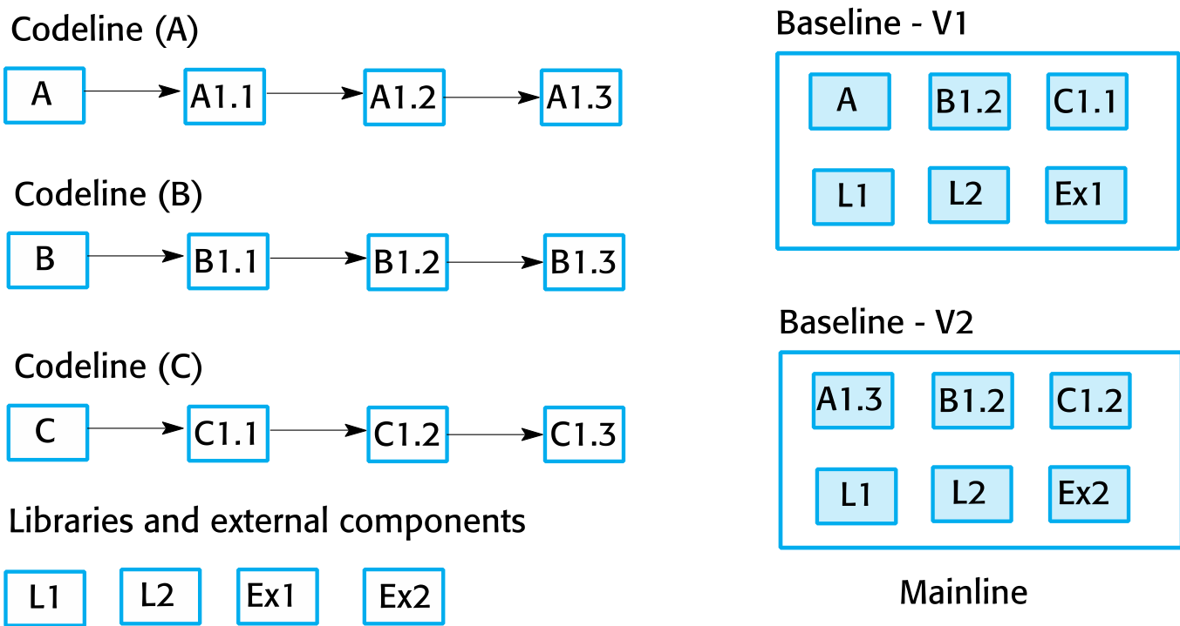
Codelines and baselines
Chapter 25 Configuration management

Slide 12
Version management systems
Version and release identification
Managed versions are assigned identifiers when they are submitted to the system.
Storage management
To reduce the storage space required by multiple versions of components that differ only slightly, version management systems usually provide storage management facilities.
Change history recording
All of the changes made to the code of a system or component are recorded and listed.
Chapter 25 Configuration management

Slide 13
Version management systems
Independent development
The version management system keeps track of components that have been checked out for editing and ensures that changes made to a component by different developers do not interfere.
Project support
A version management system may support the development of several projects, which share components.
Chapter 25 Configuration management

Slide 14
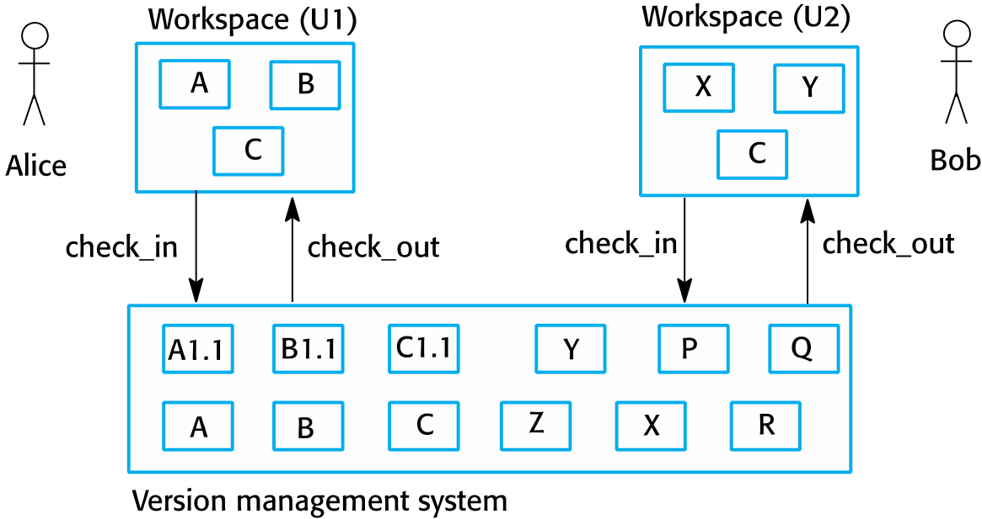
Check-in and check-out from a version repository
Chapter 25 Configuration management

Slide 15
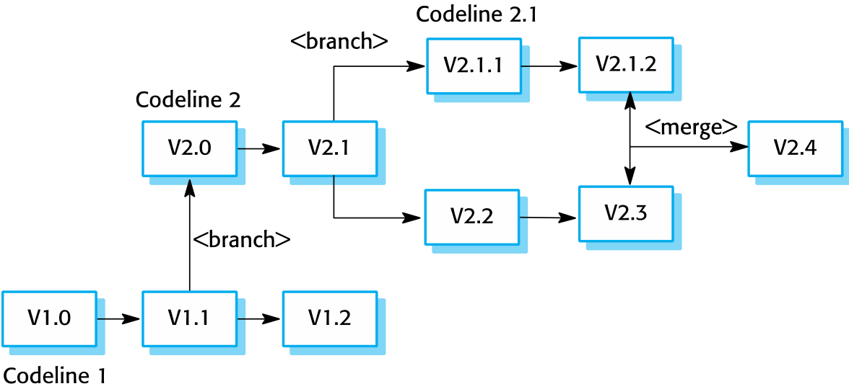
Branching and merging
Chapter 25 Configuration management

Slide 16
System building
System building is the process of creating a complete, executable system by compiling and linking the system components, external libraries, configuration files, etc.
System building tools and version management tools must communicate as the build process involves checking out component versions from the repository managed by the version management system.
The configuration description used to identify a baseline is also used by the system building tool.
Chapter 25 Configuration management

Slide 17
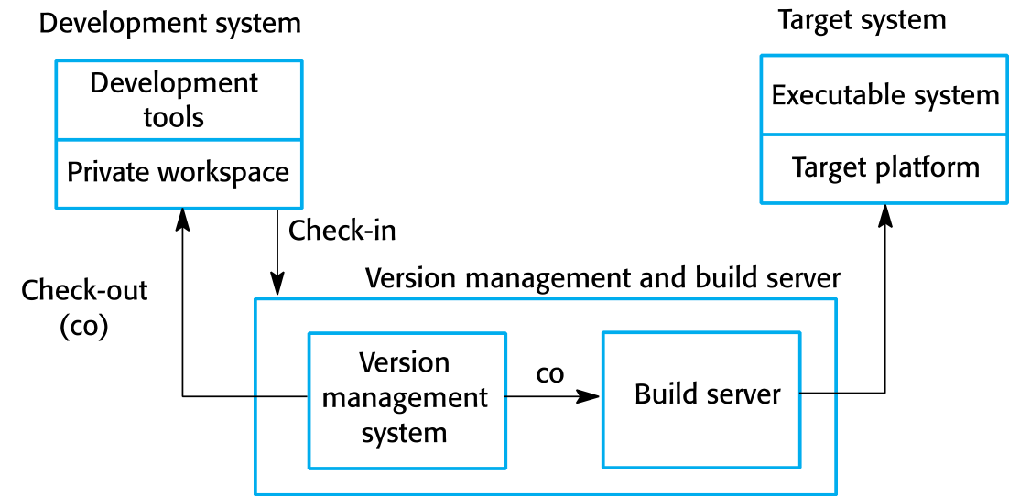
Development, build, and target platforms
Chapter 25 Configuration management

Slide 18
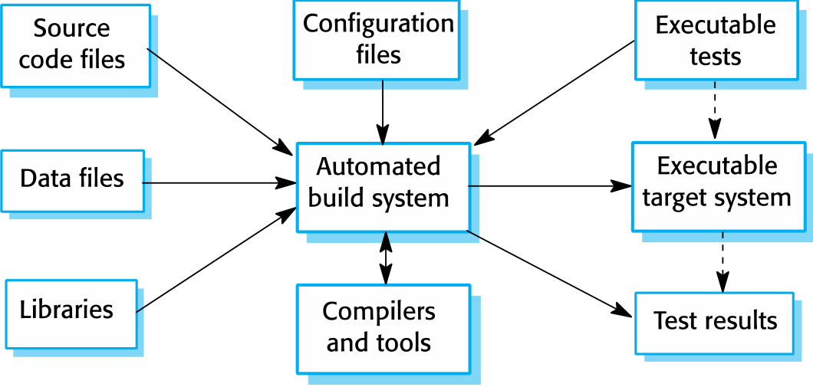
System building
Chapter 25 Configuration management

Slide 19
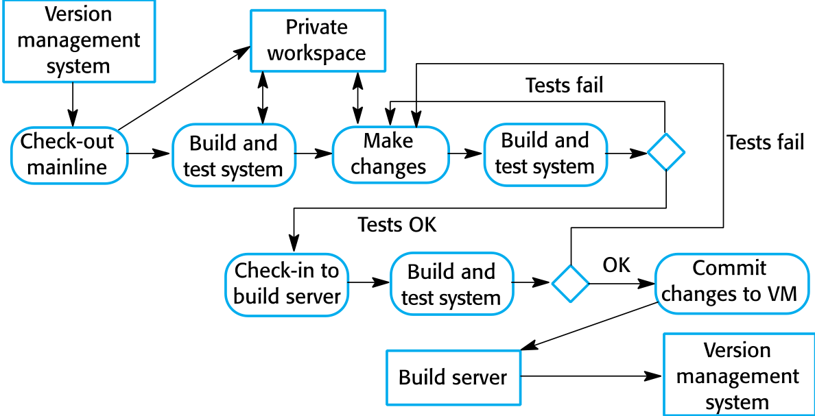
Continuous integration of agile methods
Chapter 25 Configuration management

Slide 20
Release management
A system release is a version of a software system that is distributed to customers.
For mass market software, it is usually possible to identify two types of release: major releases which deliver significant new functionality, and minor releases, which repair bugs and fix customer problems that have been reported.
For custom software or software product lines, releases of the system may have to be produced for each customer and individual customers may be running several different releases of the system at the same time.
Chapter 25 Configuration management

Slide 21
Release tracking
In the event of a problem, it may be necessary to reproduce exactly the software that has been delivered to a particular customer.
When a system release is produced, it must be documented to ensure that it can be re-created exactly in the future.
This is particularly important for customized, long-lifetime embedded systems, such as those that control complex machines.
Customers may use a single release of these systems for many years and may require specific changes to a particular software system long after its original release date.
Chapter 25 Configuration management

Slide 22
Release reproduction
To document a release, you have to record the specific versions of the source code components that were used to create the executable code.
You must keep copies of the source code files, corresponding executables and all data and configuration files.
You should also record the versions of the operating system, libraries, compilers and other tools used to build the software.
Chapter 25 Configuration management

Slide 23
Key points
Configuration management is the management of an evolving software system. When maintaining a system, a CM team is put in place to ensure that changes are incorporated into the system in a controlled way and that records are maintained with details of the changes that have been implemented.
The main configuration management processes are change management, version management, system building and release management.
Change management involves assessing proposals for changes from system customers and other stakeholders and deciding if it is cost-effective to implement these in a new version of a system.
Version management involves keeping track of the different versions of software components as changes are made to them.
Chapter 25 Configuration management

Slide 24
Key points
System building is the process of assembling system components into an executable program to run on a target computer system.
Software should be frequently rebuilt and tested immediately after a new version has been built. This makes it easier to detect bugs and problems that have been introduced since the last build.
System releases include executable code, data files, configuration files and documentation. Release management involves making decisions on system release dates, preparing all information for distribution and documenting each system release.
Chapter 25 Configuration management

